Slide 1

Term PROJECT SUBJECT : CST 2412 TOPIC :Investigating the on-going concerns/awareness related to data security

Slide 2

What is Data?
Data is simply a facts, figures or information that is stored in computer or used by the computer.
Data contains different types of information in it, some are personal information of individual like financial information or medical information, some are various plans and project or report of business organization which are very sensitive and valuable.

Slide 3
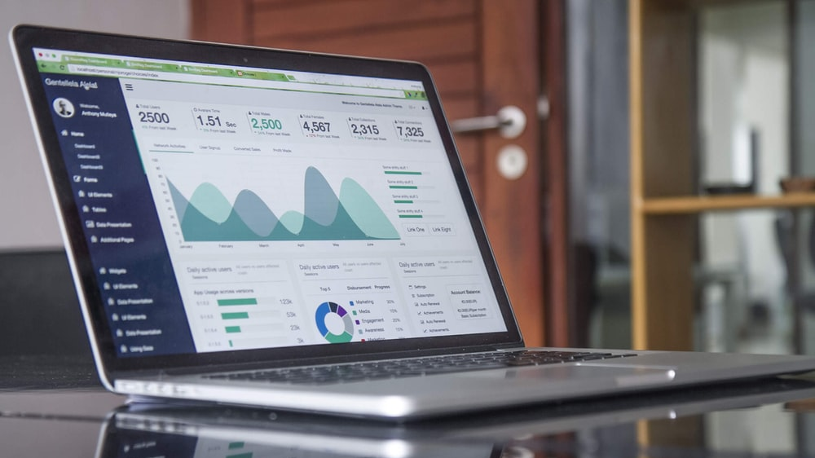

Where do we store data?
The simple answer would be Computer. Computers have changed the way we store, process, analyze and output the result of data. As we know that everything has its positive sides and negative sides, so the computers have.
While our work has been simplified by storing data in computers, there is always a great risk of misuse of data by bad intention peoples such as cyber criminals, cyber terrorist., phishing scammers and hackers. Is it very important task to maintain proper security and protection of data which has evolved a field in computer world known as data security.

Slide 4
What is Data Security?
Data security is a concept that encompasses every aspect of information security from the physical security of hardware and storage devices to administrative and access controls, as well as the logical security of software application. Implementation of proper data security can protect personal, organizational information assets against cyber criminals and guide against insider threats and human errors which remains among the leading cause of data breaches.
It uses various tools and technology available to keep our data safe and sound. There are different types of data security applied to keep of information safe such as encryption, data erasure, data masking, data resiliency and many more. Along with the technique of data security there comes another question about concern and awareness related to data security field. In further pages I will explore about important concerns and awareness related to data security [1].

Slide 5
Businesses places great value on the data they collect about their consumers. Through this information, companies can send out targeted advertising, predict sales and improve their products. But consumers naturally see it differently. For a lot of people, data collection is an invasion of their privacy and a practice that can easily be abused, leading mistrust and suspicion of many businesses
According to a survey done by KPMG, over the past years many companies have expanded their collection of data. Among the business leaders surveyed, 62% felt that their companies should do more to protect consumers data
A third of them said that consumers should be more concerned about how their data is used by companies. While 29% admitted that their company has sometimes used unethical means to collect private data. [2]

Slide 6
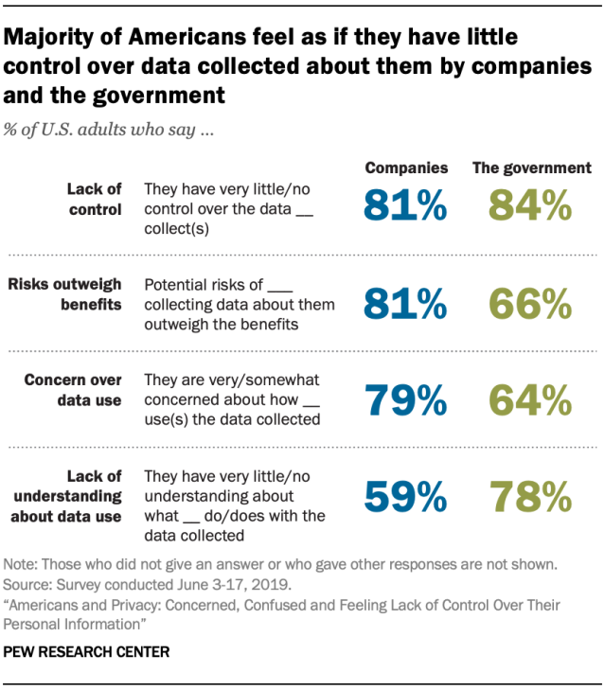
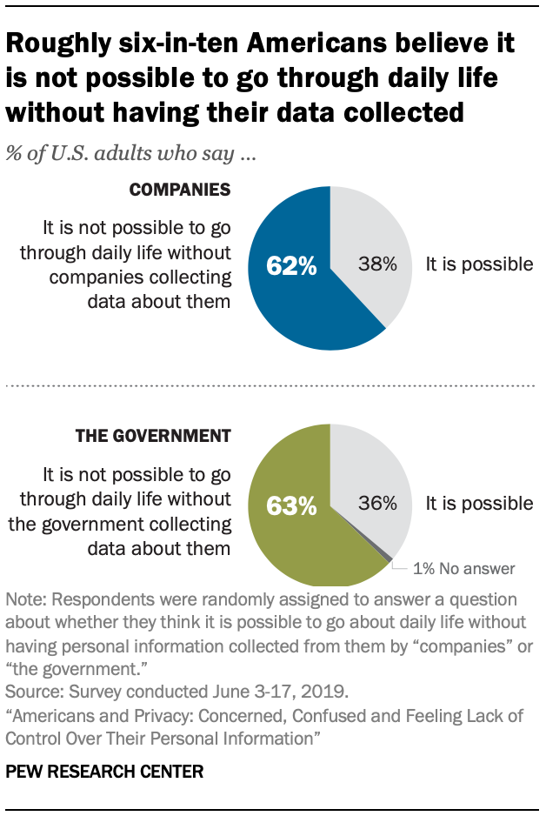
Another survey done on the consumer sides tells the whole different story. People are becoming more and more wary about their data being collected. A full 86% of the respondents said that they feel a growing concern about the data privacy, while 78% expressed fears about the amount of data being collected. Some 40% of the consumer’s don’t trust companies to use their data ethically and 13% don’t even trust their own employers. [2]
As a fear of data collection grow, people are becoming less willing to share private information. It is obvious that people worry about their data and their privacy because recently many incidents has been occurred where personal information are exposed or stolen through different companies or agencies by data breaches and hacking .[7]

Slide 7
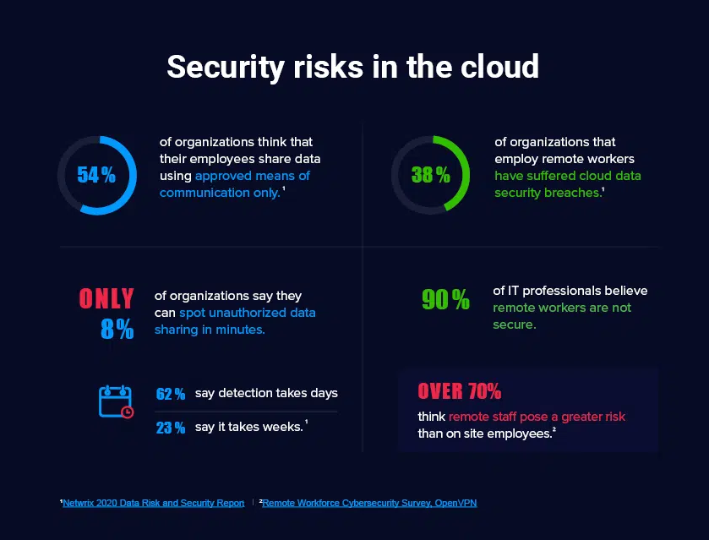
The latest big security hack came from stock trading app Robinhood, which says the data from about 7 million user accounts was compromised. Robinhood, no stranger to controversy after last spring's GameStop saga, says it was mostly email addresses leaked, and that the most sensitive and extensive data was only leaked for about 300 customers.[7]
The identity theft research center reports the number of data breaches so far in 2021 has been increased by 17% where 1291 data breaches has occurred compared to 1108 in 2020. There always has been an increase in lack of transparency in breaches notices at both the organization and government levels, which could lead to significant impact to individual [8]. Roughly three in ten Americans have experienced data breaches in past 12 months and 7 out of 10 American feels that their data is less secure today than it was 5 years ago.

Slide 8
According to research done by Pew Research Center’s some of the key concern about data security are:
Prevalence of tracking where people are being tracked by advertise, technology firms and other companies, not feeling in control of personal data.
Not feeling in control of personal data which are collected by companies, government agencies.
Concerned about how data is used by the concerned authorities.
Lack of understating about what government and companies does with the data collected. [3]
As the security concern are raising these days companies and governments are implementing new awareness policies
and measure to maintain the safety of data. Government worldwide is also addressing these challenges by mandating the new data protection regulations and privacy acts, including Global Data Protection Regulation and California Consumer Privacy Act. Regulations are introducing stricter protection standards and unprecedented fines companies must plan for and comply with up to 4% of their annual revenue for handling data. [4]
Let's discuss some of the awareness methods for data security in next pages.

Slide 9
Some awareness related to data security
1. Every user in the organization should take security awareness training.
2. The employee must understand and quickly spot actions and events that could pose a risk of data breaches.
3. The organization needs to maintain risk-based incident prioritization, more precious threat hunting, automatic redemption across security and compliance boundaries and more effective security posture management.
4. The organization can build a risk management strategy from scratch, considering building a framework like NIST risk assessment framework.
5. Identify the stale accounts in the directory of the organizational business account that have not been recently used.

Slide 10

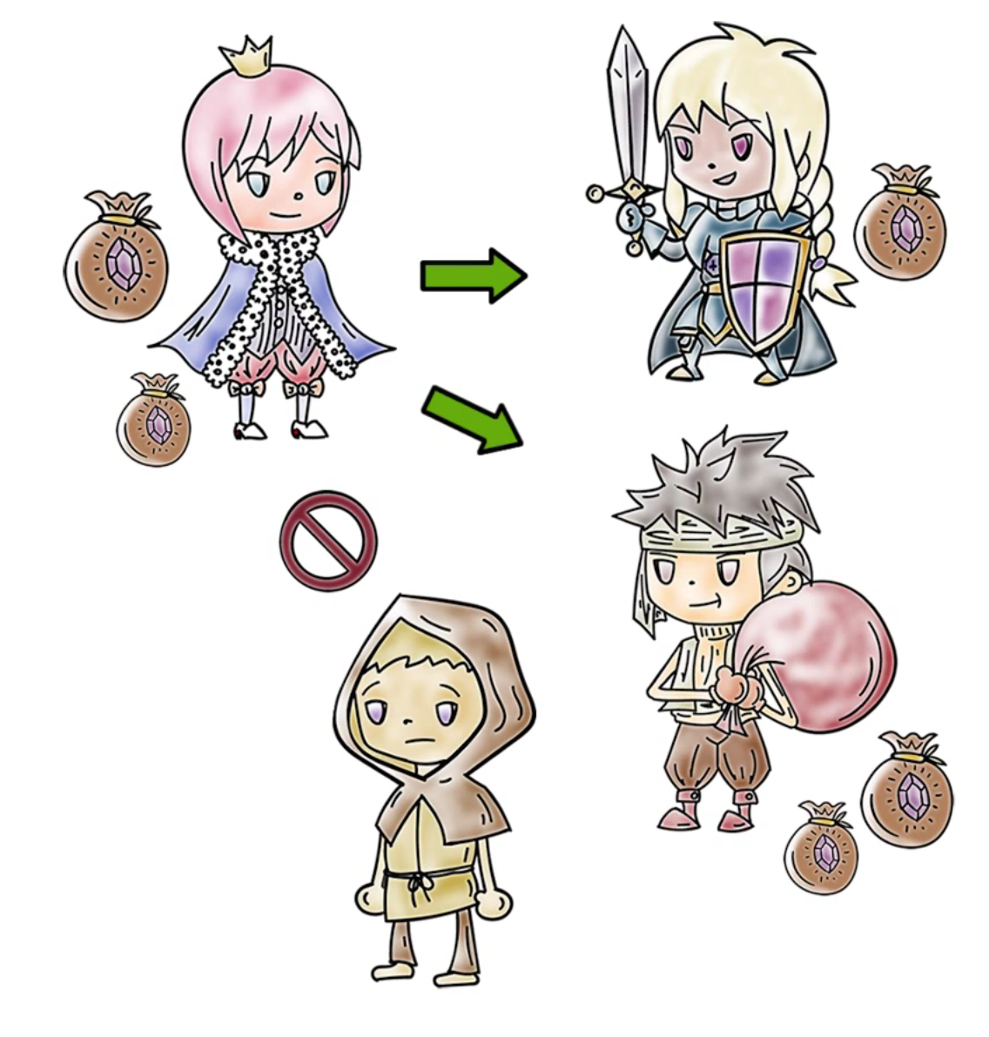

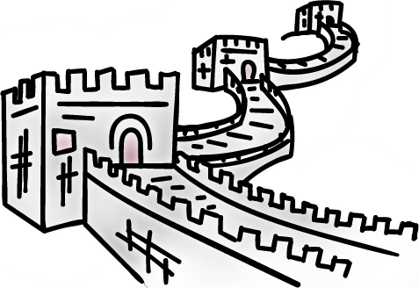
6. Use data discovery tools technology to scan data both on cloud and premises and label sensitive or regulated data by type and purpose.
7. Organization needs to maintain a least privilege model where restrict unauthorized users.
8. Always stay on top of the suspicious activities by closely auditing the IT ecosystem including all attempts to read, modify or delete sensitive data.
9. Another method of maintaining data security is using DAC where owner decides how to share and whom to share the data.
10. . Use the MAC models if possible.
11. Organization can also implement Clark-Wilson Policy where same user cannot execute two programs that required separation of duty and Chinese Wall Policy which deals with conflict of interest.

Slide 11
12. Simple techniques for individuals and organization to keep their data safe by using password for their accounts or
important data which are long and contains numbers, letters, characters, and symbols.
13. If available use VPN.
14. Never open an email or link which are not familiar or look suspicious.
Ultimately, we cannot say that we can have a complete security of our data because as the technology progress, the risk of data loss increase. They are like two sides of a coin. But maintaining the above policies and methods reduced maximum number of risk of data loss and maintain high security of data.

Slide 12
References:
1.
“What is Data Security?,” What is Data Security? Data Security Definition and Overview.
[Online]. Available: https://www.ibm.com/topics/data-security. [Accessed: 27-Oct-2021].
2.
L. Whitney, “Data privacy is a growing concern for more consumers,” TechRepublic, 17-Aug-2021.
[Online]. Available: https://www.techrepublic.com/article/data-privacy-is-agrowing-concern-for-more-consumers/. [Accessed: 27-Oct-2021].
3.
B. Auxier, L. Rainie, M. Anderson, A. Perrin, M. Kumar, and E. Turner, “Americans andprivacy: Concerned, confused and feeling lack of control over their personal information,”Pew Research Center: Internet, Science & Tech, 17-Aug-2020. [Online]. Available:
https://www.pewresearch.org/internet/2019/11/15/americans-and-privacy-concernedconfused-and-feeling-lack-of-control-over-their-personal-information/. [Accessed: 27-Oct-2021].
4.
M. Gindi, “Data Awareness is key to data security,” Dark Reading, 10-Sep-2021. [Online].Available: https://www.darkreading.com/risk/data-awareness-is-key-to-data-security.
[Accessed: 27-Oct-2021].

Slide 13
5.
R. Patel, “Data Protection 101: Why you need security awareness training: Explore ourthinking,” Plante Moran, 25-Jun-2019. [Online]. Available:https://www.plantemoran.com/explore-our-thinking/insight/2019/06/data-protection-101-
why-you-need-security-awareness-training. [Accessed: 27-Oct-2021].
6.
Mike Tierney VP of Customer Success at Netwrix. Mike is responsible for the overallcustomer experience. He has a diverse background built over 20 years in the software, “DataSecurity explained: Challenges and solutions,” Netwrix Blog.
[Online]. Available:https://blog.netwrix.com/2021/07/26/data-security/. [Accessed: 27-Oct-2021].
7.
S. Brown, “Robinhood data breach is bad, but we've seen much worse,” CNET. [Online]. Available: https://www.cnet.com/tech/services-and-software/robinhood-data-breach-is-bad-but-weve-seen-much-worse/. [Accessed: 02-Dec-2021].
8.
Fortune. 2021. 2021's data breaches have already topped 2020's total. [online] Available at: <https://fortune.com/2021/10/06/data-breach-2021-2020-total-hacks/> [Accessed 2 December 2021].
############################THE END##########################

